Slide 1
A Seminar on Block Chain Technology In Agriculture Product Supply Chain
Team Details
Ch.Thanmai (20EG105609)
A.Devika (20EG105639)
M.Harshith Varma (20EG105712)
N.Sujeeth Kumar (20EG105717)
Project Supervisor
Mr.K.Sadanandam
Assistant Professor

Slide 2
Introduction
Blockchain technology in agriculture product supply chains offers a decentralized and transparent system for tracking the journey of products from farm to table.
Due to globalization in various fields, agriculture sector is calling for new techniques and innovations. One such technology is blockchain.
Firstly, blockchain technology is an application of distributed ledger technology. It consists of associated chains that store data in units called blocks.
A supply chain refers to the design, engineering production and distribution process of goods from suppliers to consumers.
These supply chain are prone to error, hacking and they are over reliant on the centralized database(single point failure problem).
One significant application is enhancing traceability and transparency throughout the entire supply chain process. By recording every transaction and movement of products on an immutable ledger, blockchain enables complete traceability from farm to table. This transparency not only provides consumers with verifiable information about the origin and journey of their food but also allows stakeholders to track quality standards, ensuring that products meet regulatory requirements and consumer expectations.

Slide 3
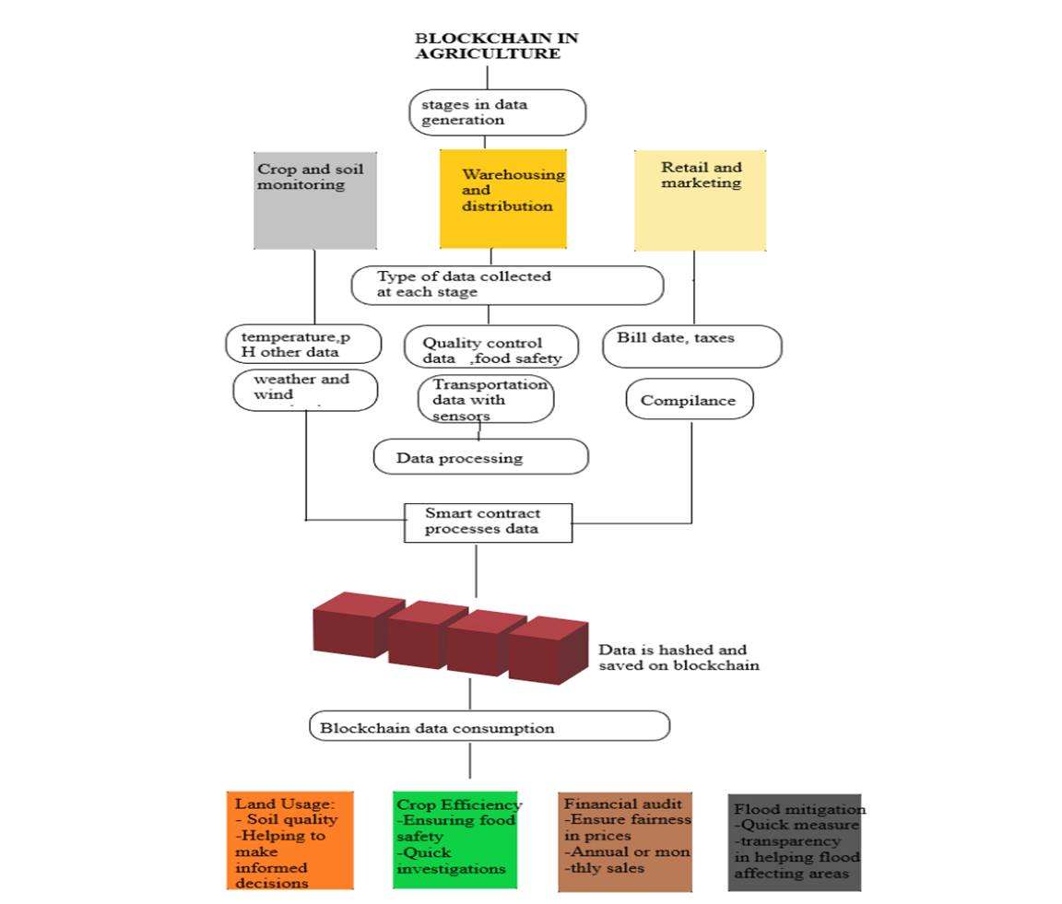
Concept Tree

Slide 4
Literature
Author(s) | Strategies | Advantages | Disadvantages
Brewin D. | The impact of COVID-19 on the grains and oilseeds sector. Can. J. Agric. | Enhance the grains and oilseeds sector, careful consideration of the associated | crucial for successful implementation.
Chofreh A.G., Goni F.A., Jofreh M.G. | Enterprise resource planning (ERP) implementation process: project management perspective. | Its ability to integrate diverse business processes, ensuring data accuracy and offering enhanced efficiency through automation. | substantial upfront costs, potential challenges related to system complexity and customization, employee resistance to change, and the time-consuming
Events Reuters. 2018 | Global blockchain market for the supply chain expected to grow at 87% CAGR until 2023 | It signifies a rising recognition of blockchain's potential to enhance transparency and traceability in supply chain operations. | terms of skill shortages and the ability of businesses to adapt quickly to evolving blockchain technologies in the supply chain sector.

Slide 5
Literature(cont...)
Author(s) | Method | Advantages | Disadvantages
Galanakis C.M. | The food systems in the era of the coronavirus (COVID-19) pandemic crisis. | Embracing technological solutions for distribution and supply chain management, | challenges may arise, such as disruptions in global supply chains, impacting the availability of certain food products.
Jumia.2020 | UNDP, JUMIA Uganda partner to link market vendors with consumers | This partnership may enhance market access, increase sales opportunities for local vendors | potential exclusion of vendors who lack access to digital platforms or face technological barriers. Issues related to logistics, such as delivery infrastructure and transportation,
Kalla A., Hewa T., Mishra R.A., Ylianttila M., Liyanage M | The role of blockchain to fight against COVID-19. | enhanced transparency in tracking the distribution and administration of vaccines and medical supplies. | the need for standardized protocols, potential regulatory hurdles, and concerns about data privacy.

Slide 6
Problem Statement
Existing agriculture supply chains face challenges such as limited traceability, delayed transactions, and trust issues. Integrating blockchain technology can enhance efficiency by establishing a transparent and decentralized ledger. This solution ensures real-time tracking, reduces delays, minimizes fraud, and fosters trust among participants, thereby optimizing the agricultural product supply chain.

Slide 7
Problem Illustration
All existing techniques were using centralized server (single main server) to store data and if this server hack by malicious users then they can easily alter data on that servers and user’s may get wrong or fake data and there is no proper software to detect that alteration and to overcome from this problem Blockchain technology has been introduced.
Blockchain support decentralized (data stores at multiple nodes) storage and each node will store data as block of transaction by associating each block with hash code and whenever new data arrive for storage then all nodes will verify hashcode of existing blocks and if all nodes contains same hashcode then data will be consider as secured and unaltered and then new block will be added.
If any node report incorrect hashcode then that node consider as attacked and then collect data from genuine nodes. Above verification of hashcode is consider as PROOF OF WORK.

Slide 8
Proposed Method
In propose work we are using IOT networks and this IOT network consists of following operations 1. Generate Network: using this module IOT network will get setup 2. Cluster Head Selection: all IOT networks exchange there available battery power and then check which IOT covering more number of nodes and can reached to base station with less energy consumption then that node will be elected as cluster head. 3. Collect Data: using this module IOT will collect/sense food data from agriculture farm. 4. Data Transmission Routing Phase: using this module IOT will find shortest path to reached cluster head and then transfer data to selected cluster head. CH will send data to base station. Base station will collect data and then store in Blockchain node. Blockchain store each data as block of transaction and will generate hashcode for verification 5. View Blockchain Data: various users such as consumer, farmers, distributors and many more users may use this module to retrieve data from Blockchain and view it. In this project they have used IOT sensors and agriculture field but we don’t have any sensors so we built this concept as simulation.

Slide 9
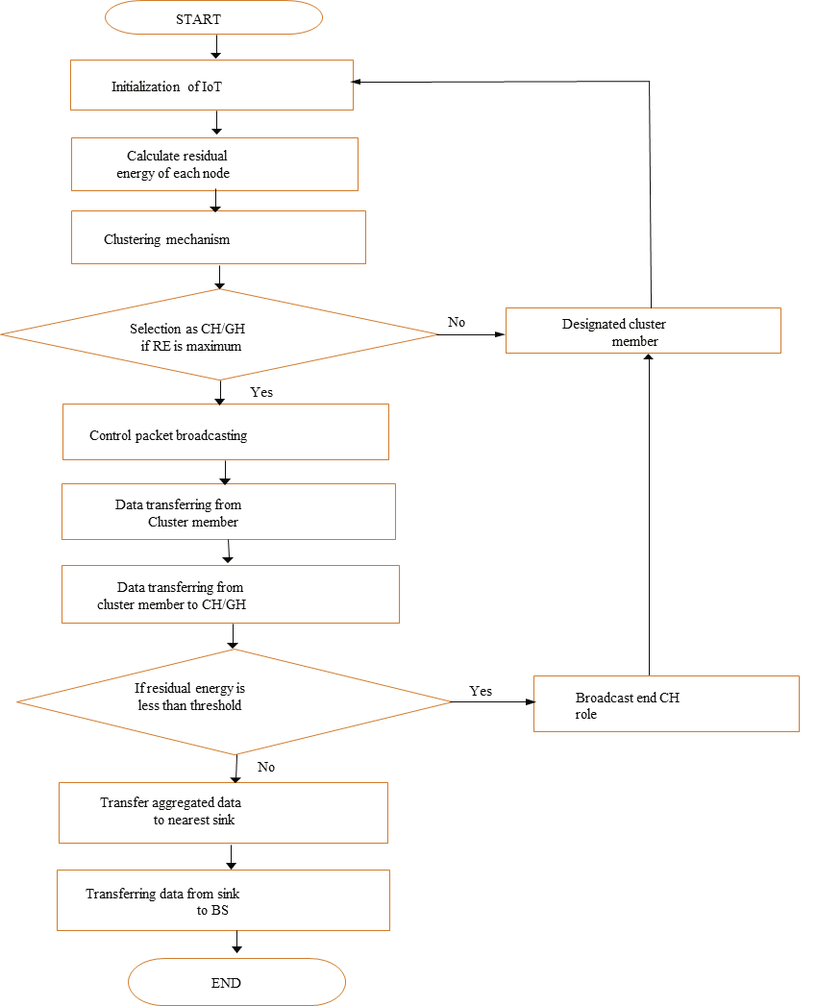
Proposed Method Illustration

Slide 10
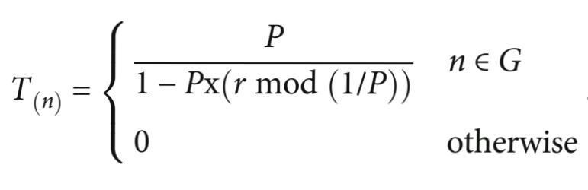
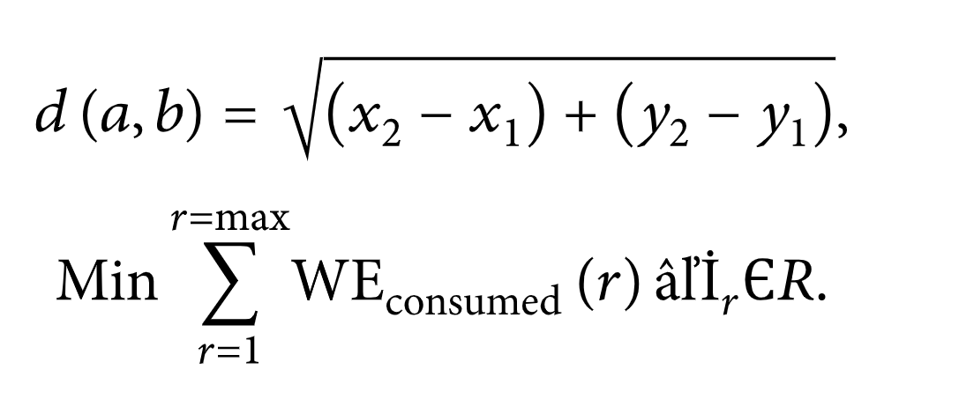
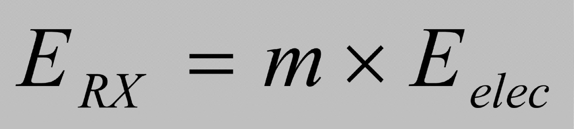
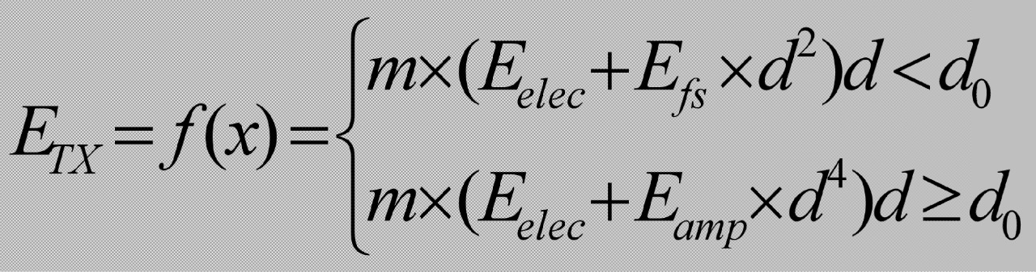
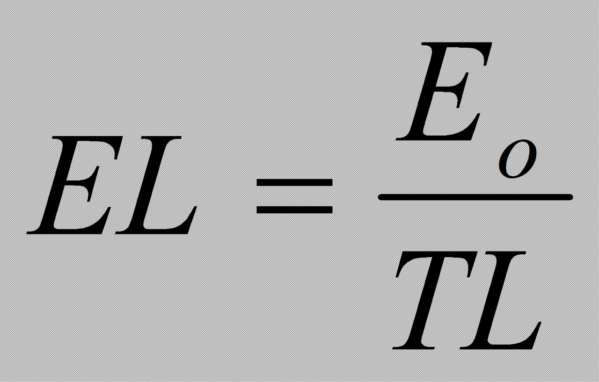
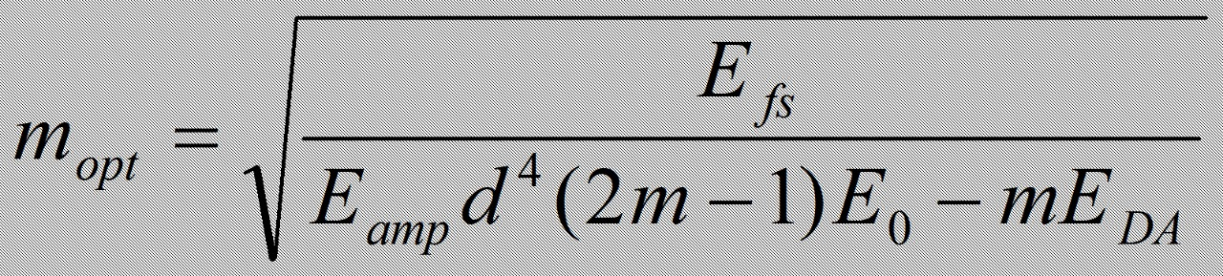
Parameter
Cluster Head (CH) Selection :
Used to calculate the threshold (Tn):
The Euclidean distance between any two nodes :

Slide 11
Experiment Environment
HARDWARE REQUIREMENTS:
System : Pentium Dual Core.
Hard Disk : 120 GB.
Monitor : 15’’ LED
Input Devices : Keyboard, Mouse
Ram : 4 GB
SOFTWARE REQUIREMENTS:
Operating system : Windows 10
Coding Language : python
Tool : Python
Database : dataset
Server : Flask

Slide 12
Project status
S.No | Functionality | Status (Completed /in-progress/Not started)
1 | Data Collection | Completed
2

Slide 13
References
M. M. Aung and Y. S. Chang, ``Traceability in a food supply chain: Safety and quality perspectives,'' Food Control, vol. 39, pp. 172_184, May 2014.
T. Bosona and G. Gebresenbet, ``Food traceability as an integral part of logistics management in food and agricultural supply chain,'' Food Control, vol. 33, no. 2, pp. 32_48, 2013.
J. Hobbs, ``Liability and traceability in agri-food supply chains,'' in Quan- tifying the Agri-Food Supply Chain. Springer, 2006, pp. 87_102.
D. Mao, Z. Hao, F. Wang, and H. Li, ``Novel automatic food trading system using consortium blockchain,'' Arabian J. Sci. Eng., vol. 44, no. 4, pp. 3439_3455, Apr. 2018.
L. U. Opara and F. Mazaud, ``Food traceability from _eld to plate,'' Outlook Agricult., vol. 30, no. 2, pp. 239_247, 2001.
Li, Q., W a n g , M ., Gu , W .: Co mp u t e r Vis io n Ba s e d Systemfor Apple Surface Defect Detection. Computers and Electronics in Agriculture 36, page 215-223 .

Slide 14
Thank you

Slide 15
Project seminar–I Evaluation
S.No | Rubrics | Marks
1 | Concept Introduction | 4
2 | Literature and Parameter | 5
3 | Problem and Problem Illustration | 8
4 | Proposed Method and Illustration | 8
Total |  | 25

